Slide 1
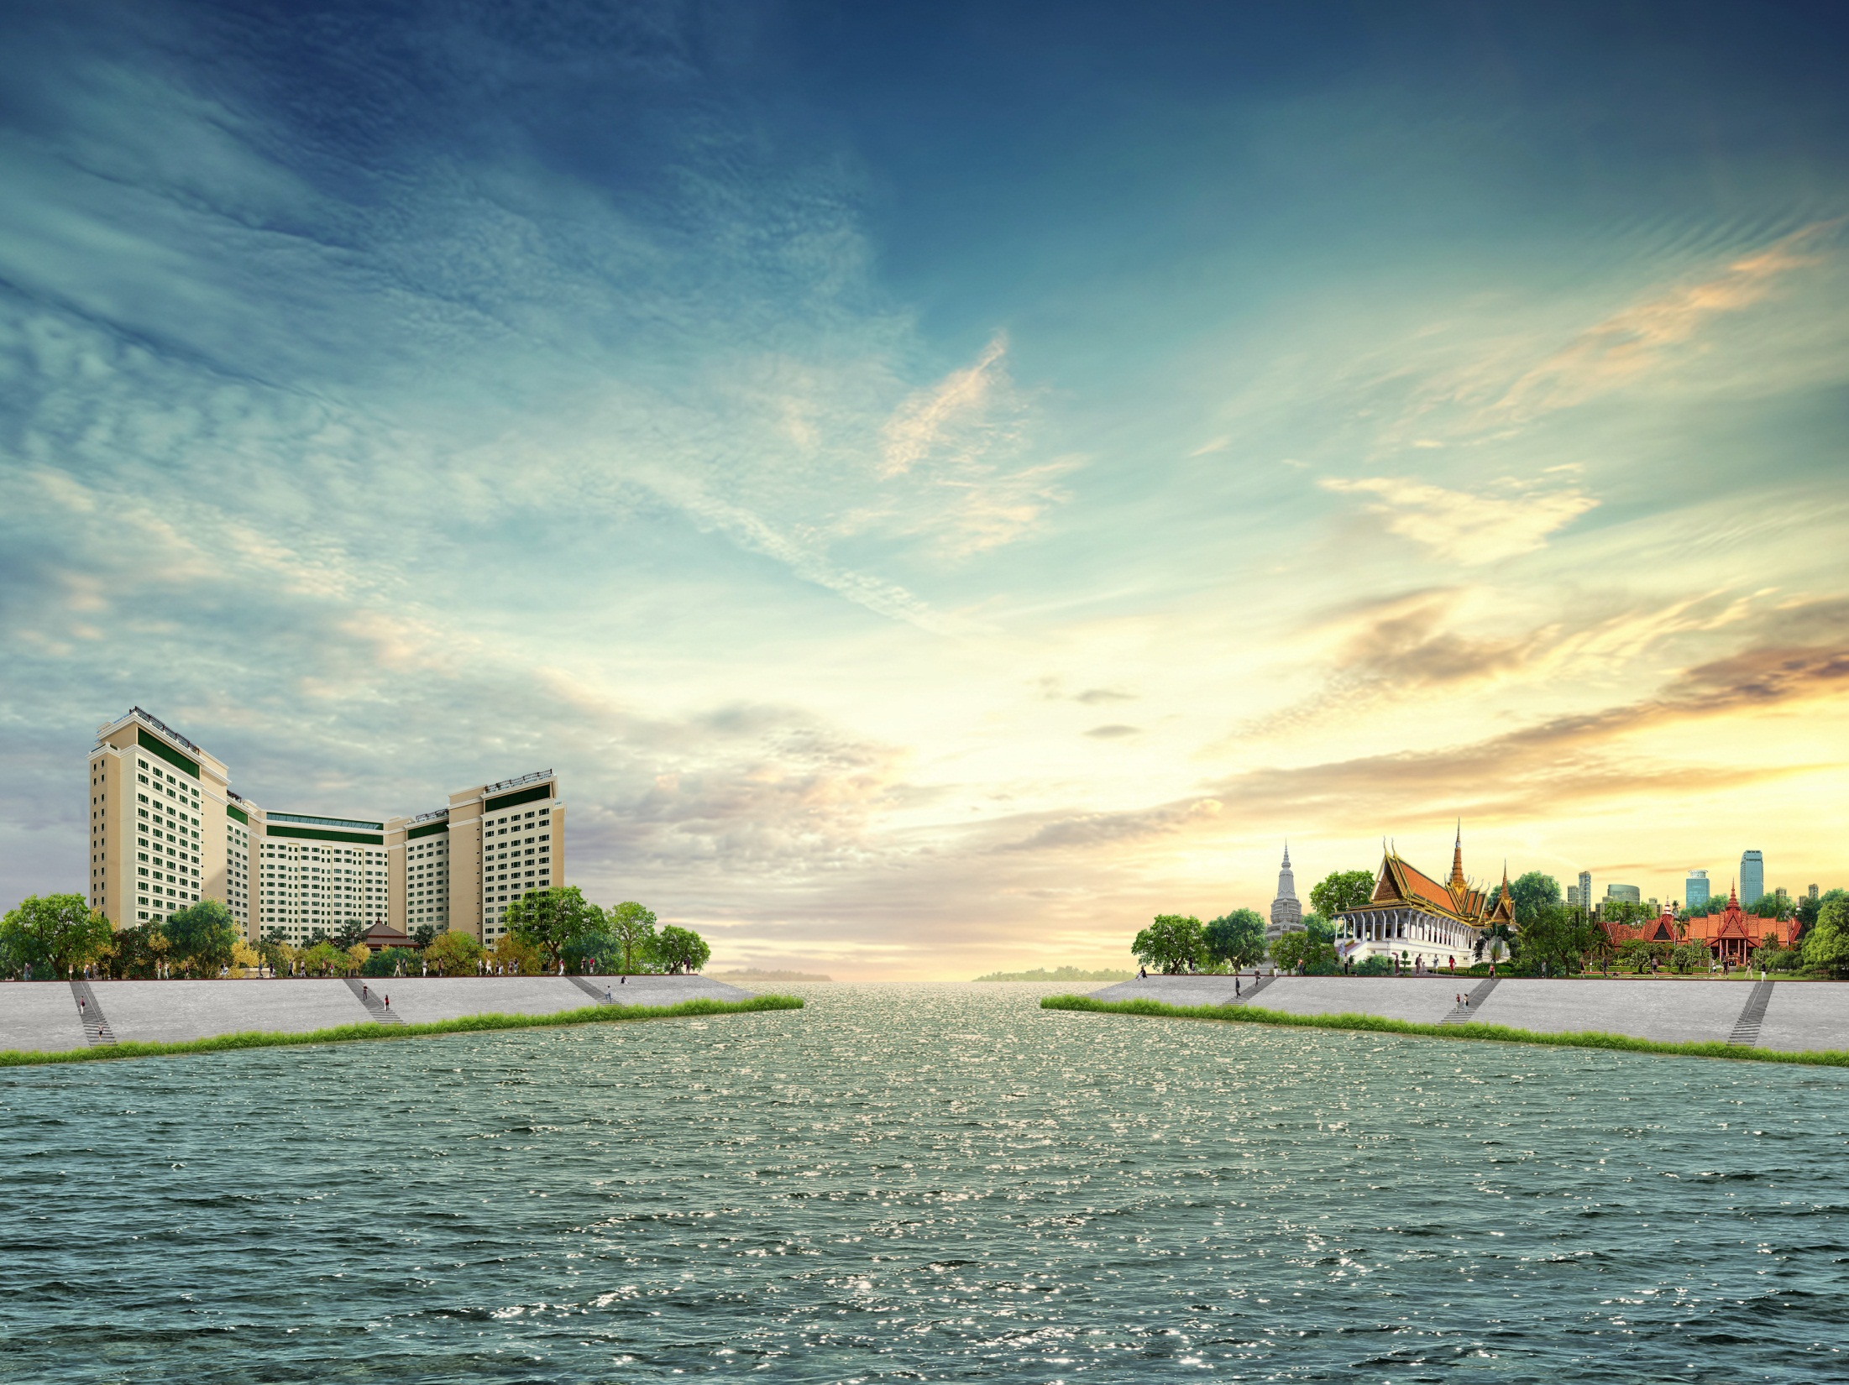

WELCOME
_______________
SOKHA PHNOM PENH HOTEL & RESIDENCE

Slide 2

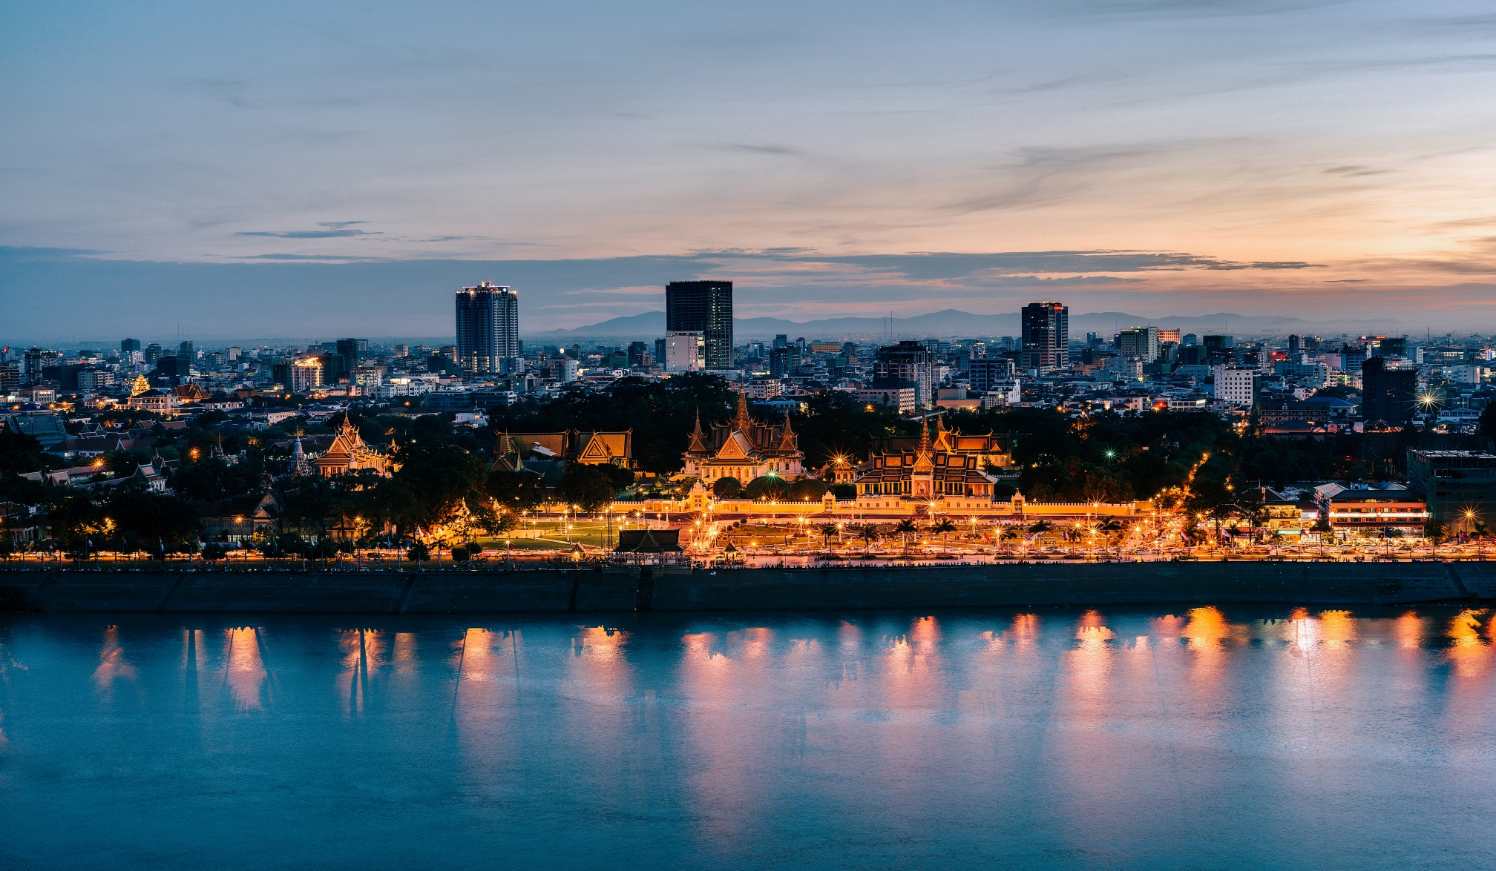

Incomparable Location
A Wealth of River Views
A Sanctuary of Peace and Tranquility
A True Khmer Hospitality

Slide 3

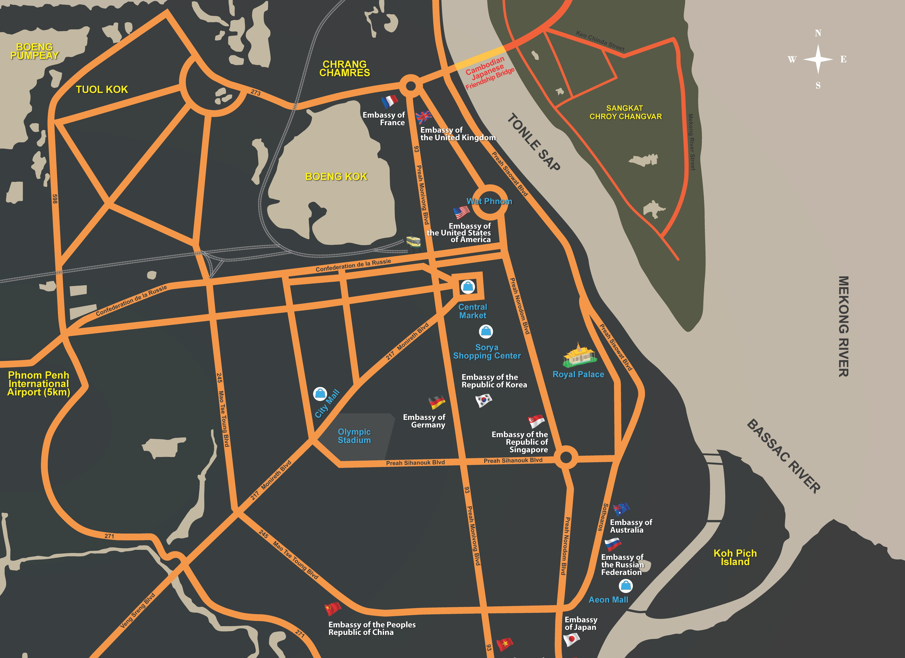

TO:
Airport 30min
Aeon Mall 15min
Wat Phnom 06min
Night Market 06min
Central Market 08min
Sorya Mall 09min
National Museum 10min
Royal Palace 10min
Riverside 10min
Ind’ Monument 12min

Slide 4
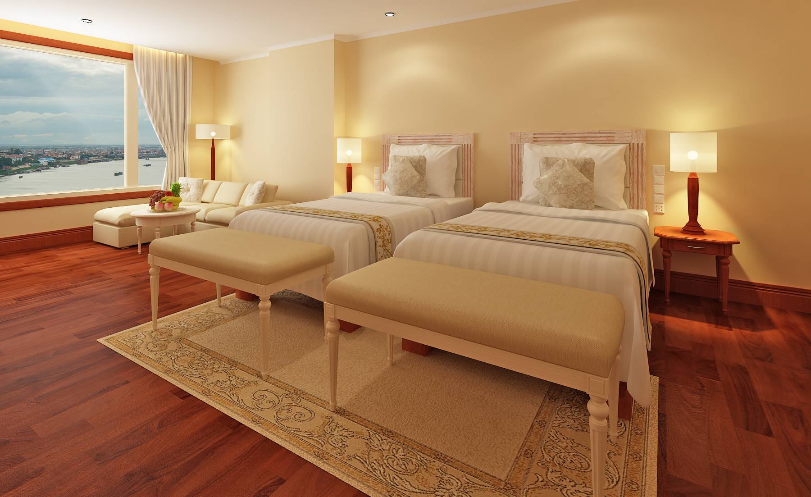
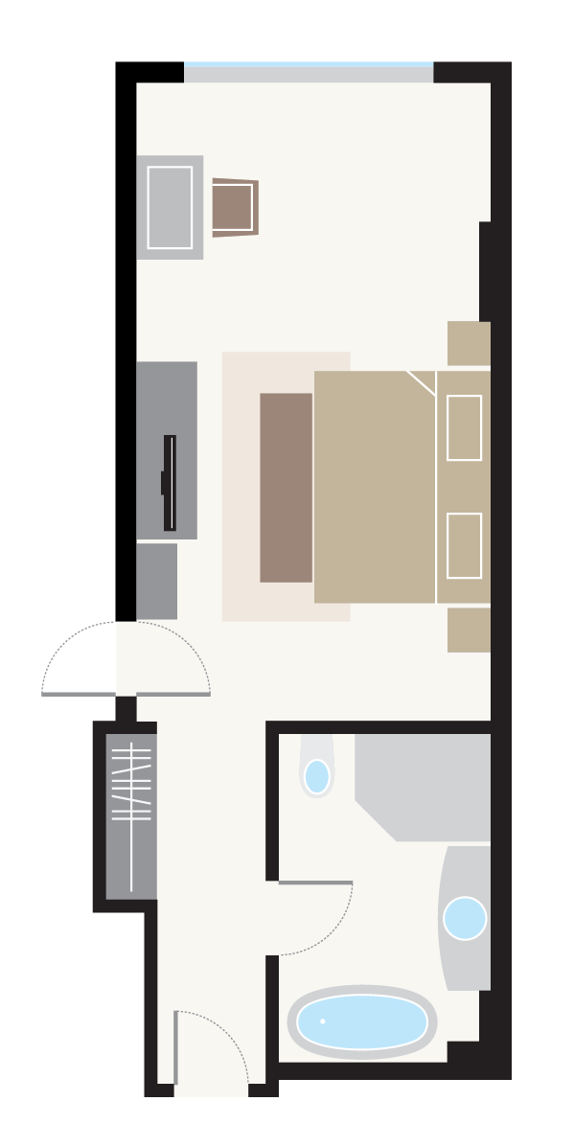
Deluxe (52 sqm/ 560 sqf)
Timber floor

Slide 5
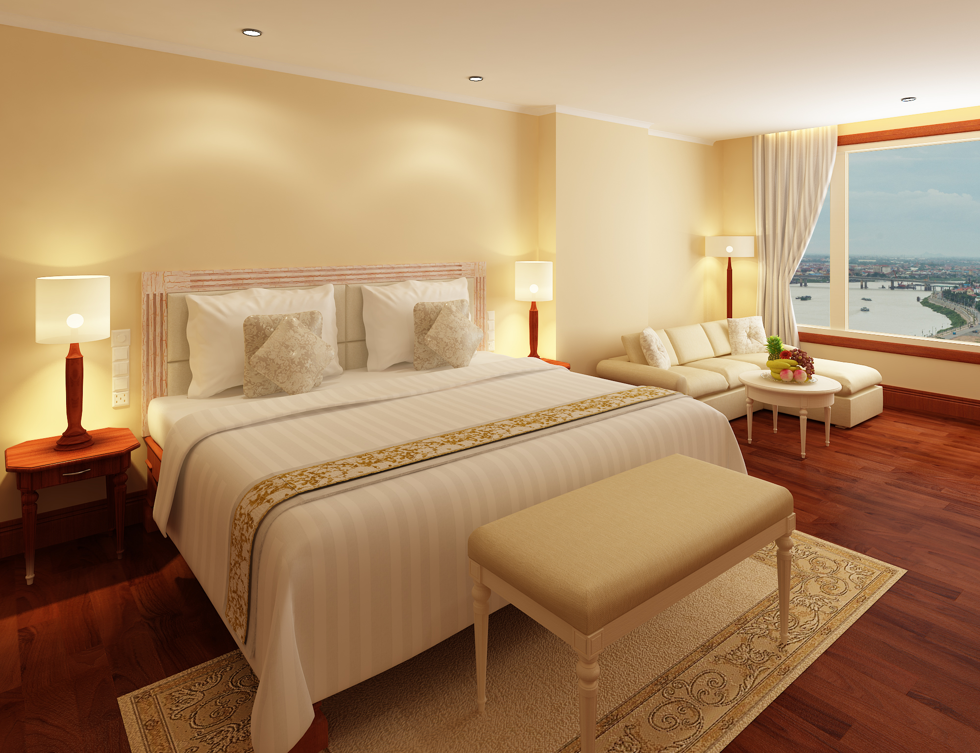
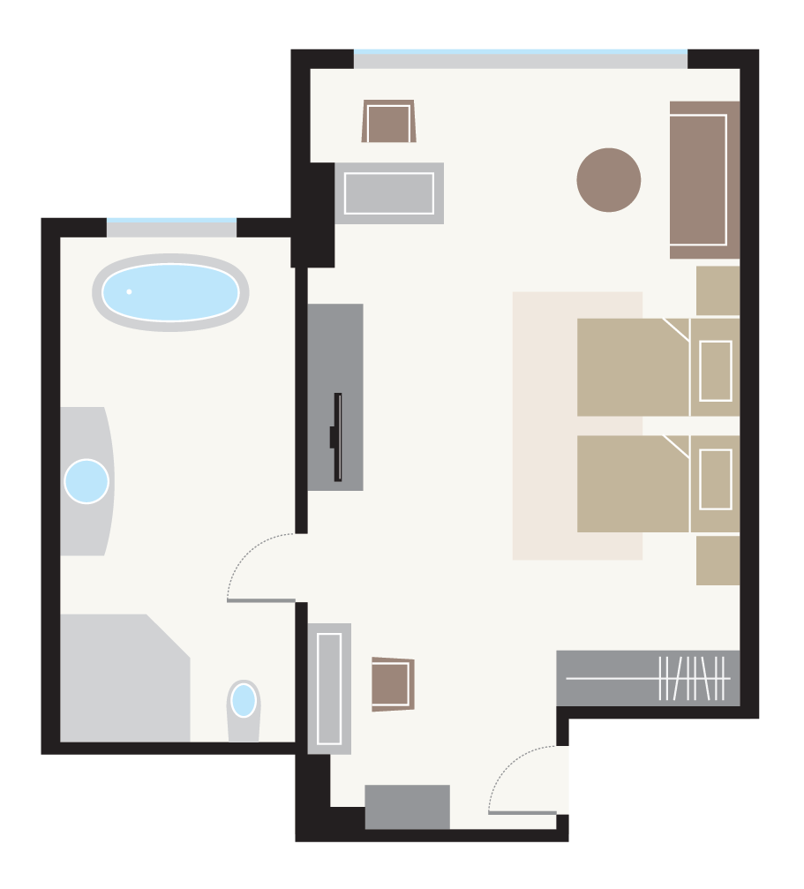
Premier (56 sqm/ 603 sqf)
Japanese high tech washlet

Slide 6

Club Deluxe (52 sqm/ 560 sqf)
Mohori Lounge access

Slide 7
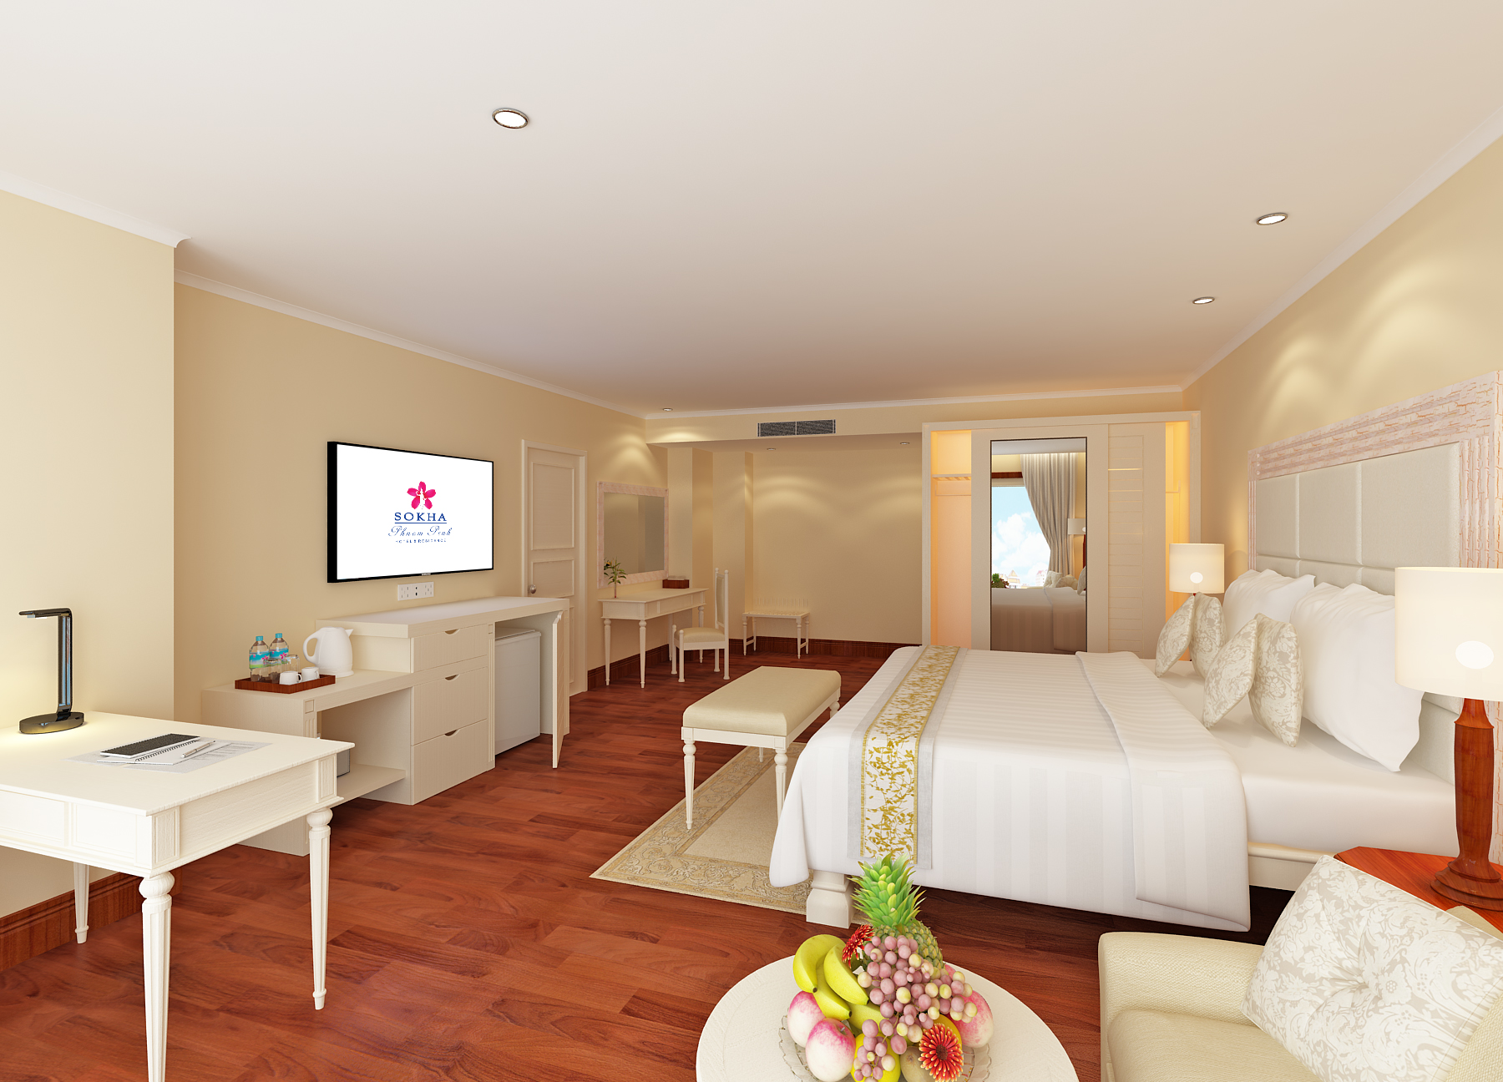
Club Premier (56 sqm/ 603 sqf)
Japanese high tech washlet
Mohori Lounge access

Slide 8
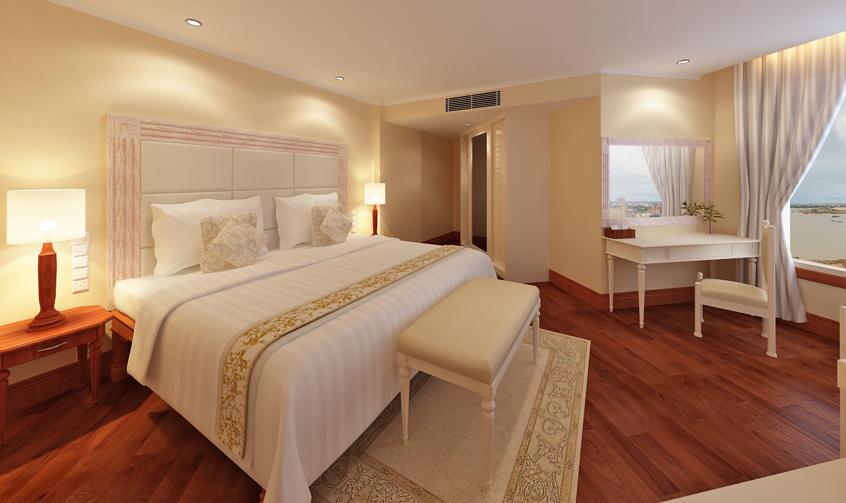
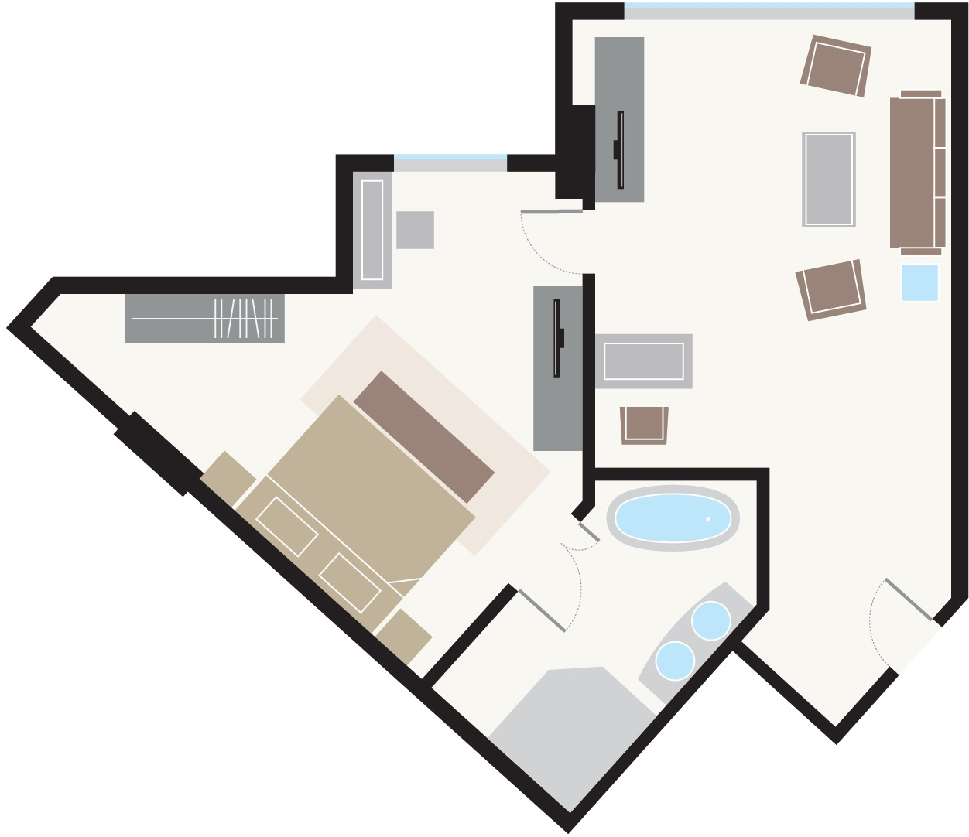
Club Suite (71 sqm/ 764 sqf)
Japanese high tech washlet
Mohori Lounge access

Slide 9
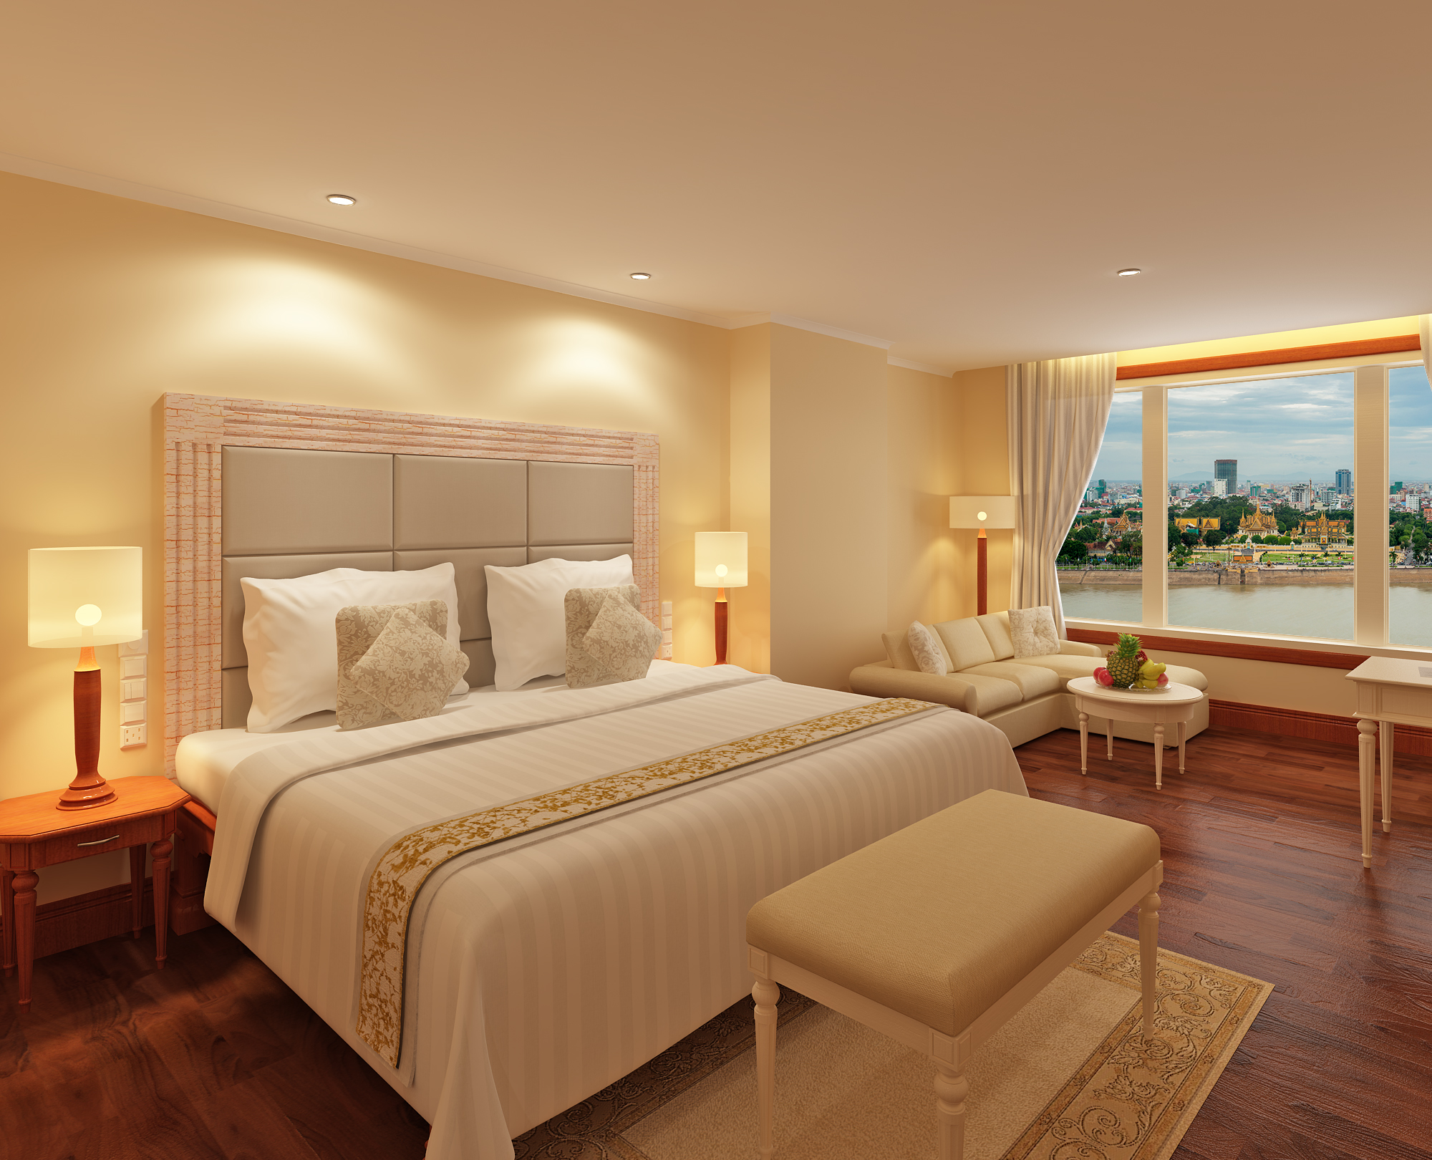
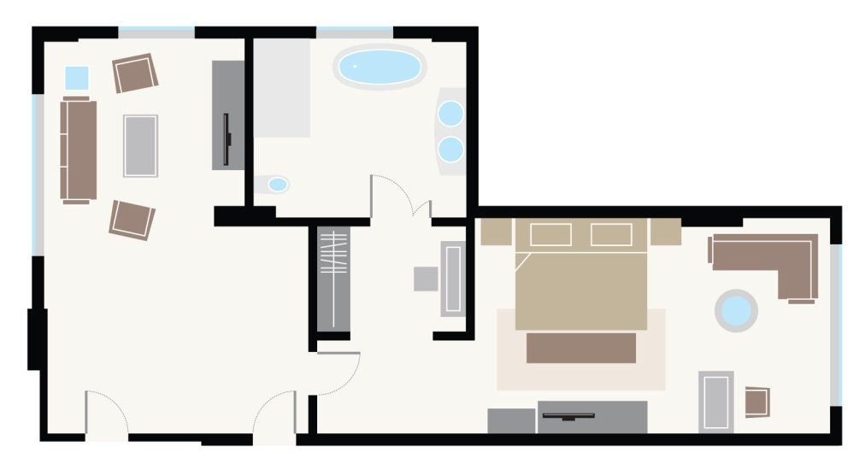
Junior Suite (93 sqm/ 1,000 sqf)
1 bedroom + living room
Mohori Lounge access

Slide 10
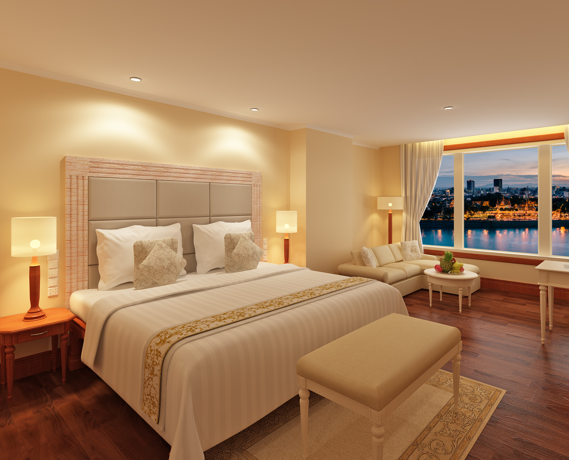
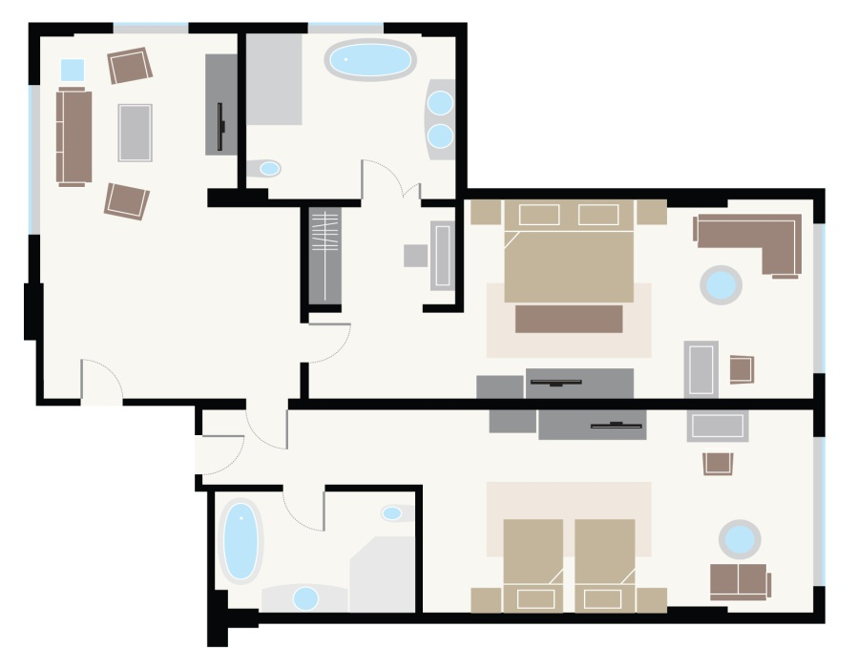
Executive Suite (146 sqm/ 1,571 sqf)
2 bedrooms + living room
Mohori Lounge access

Slide 11
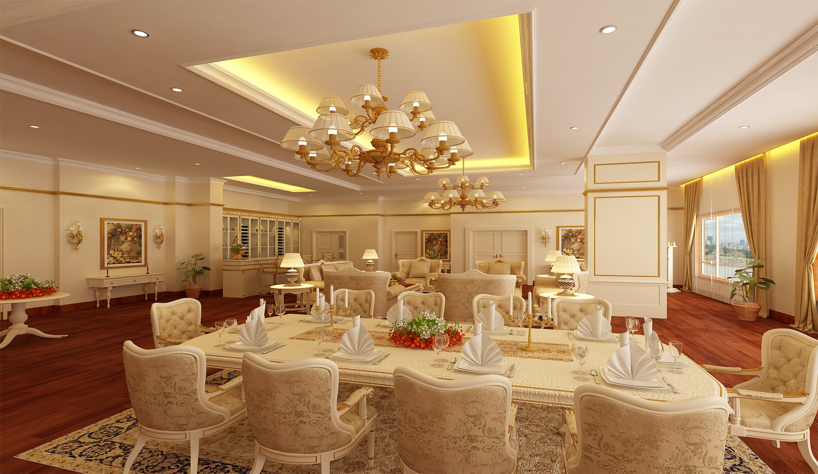
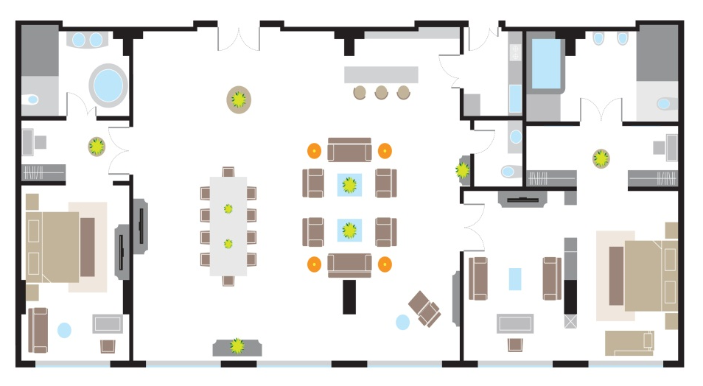
Royal Sokha Suite (318 sqm/ 3,422 sqf)
2 bedrooms + living room + dining area
Mohori Lounge access

Slide 12
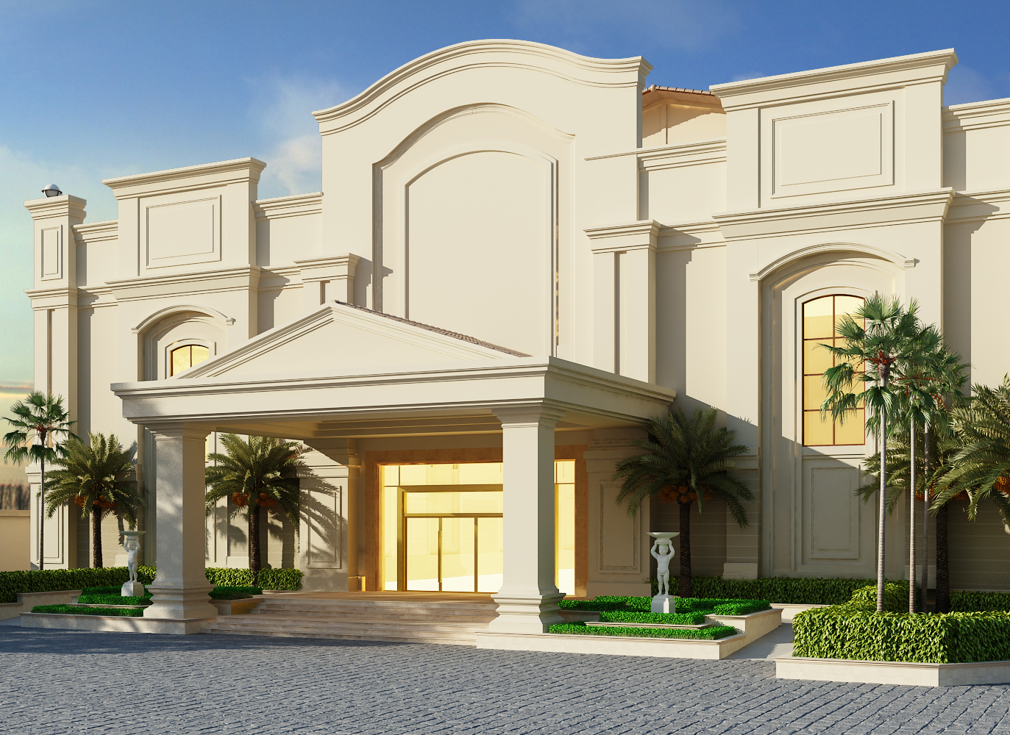
MICE Facility
Separate entrance
3,100 persons capacity
8 breakout rooms

Slide 13
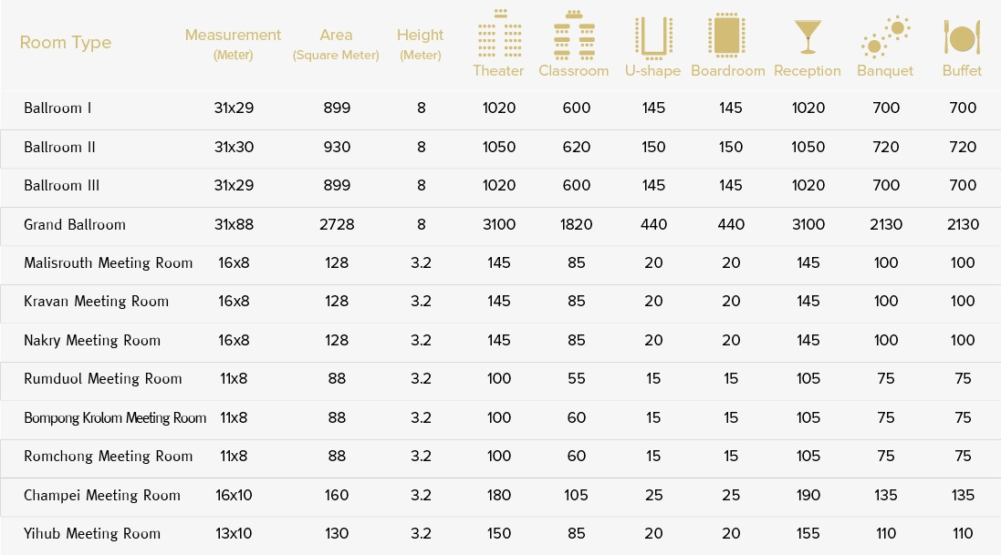
CONFERENCE CENTRE CONFIGURATION

Slide 14
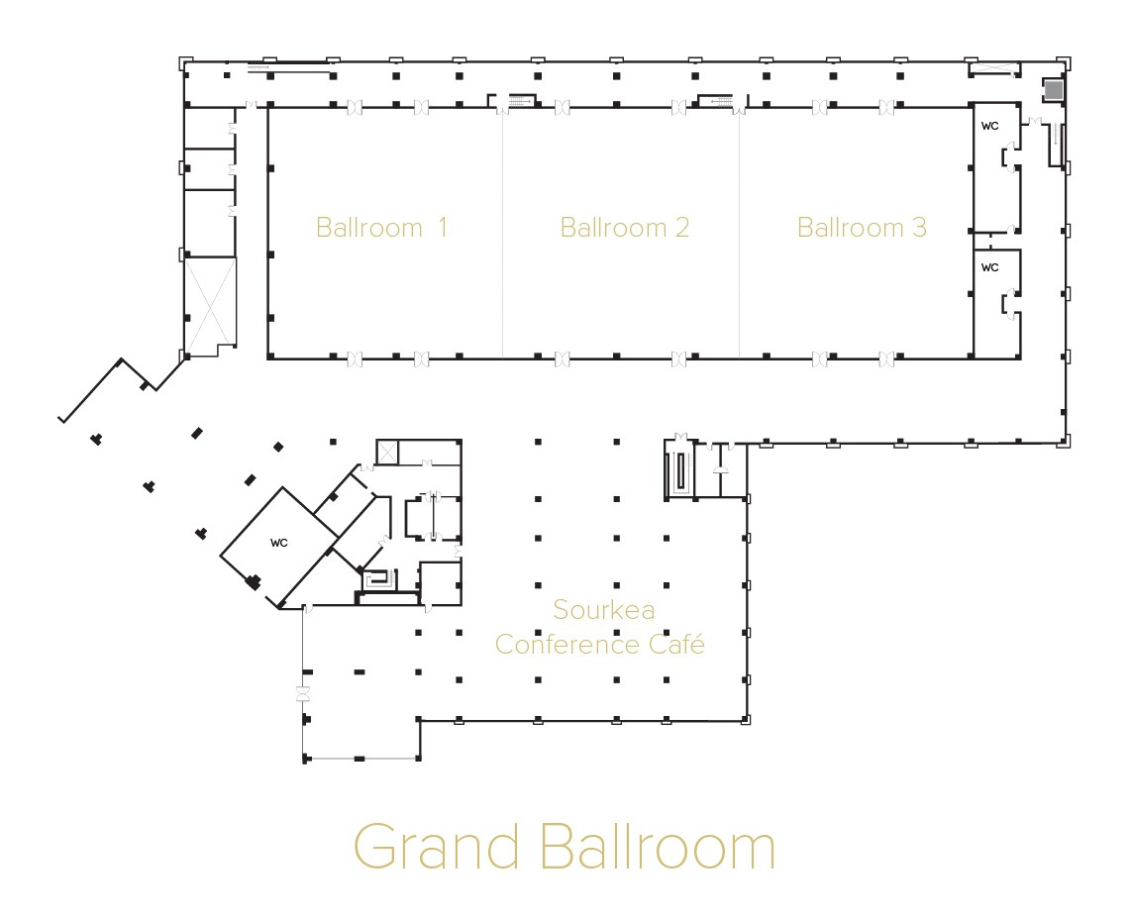

Slide 15
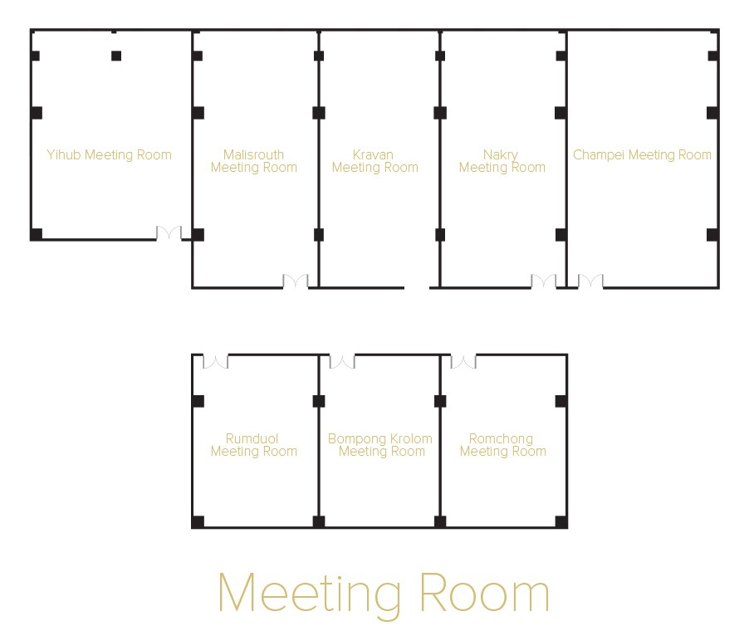

Slide 16
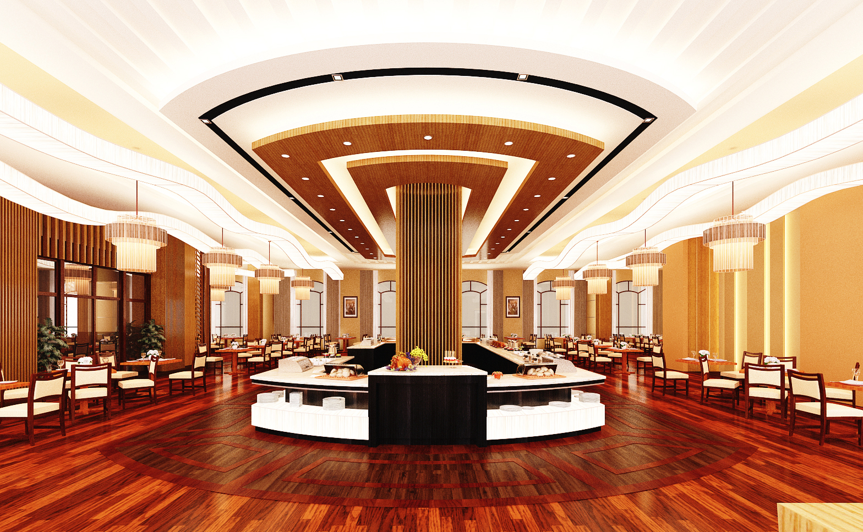
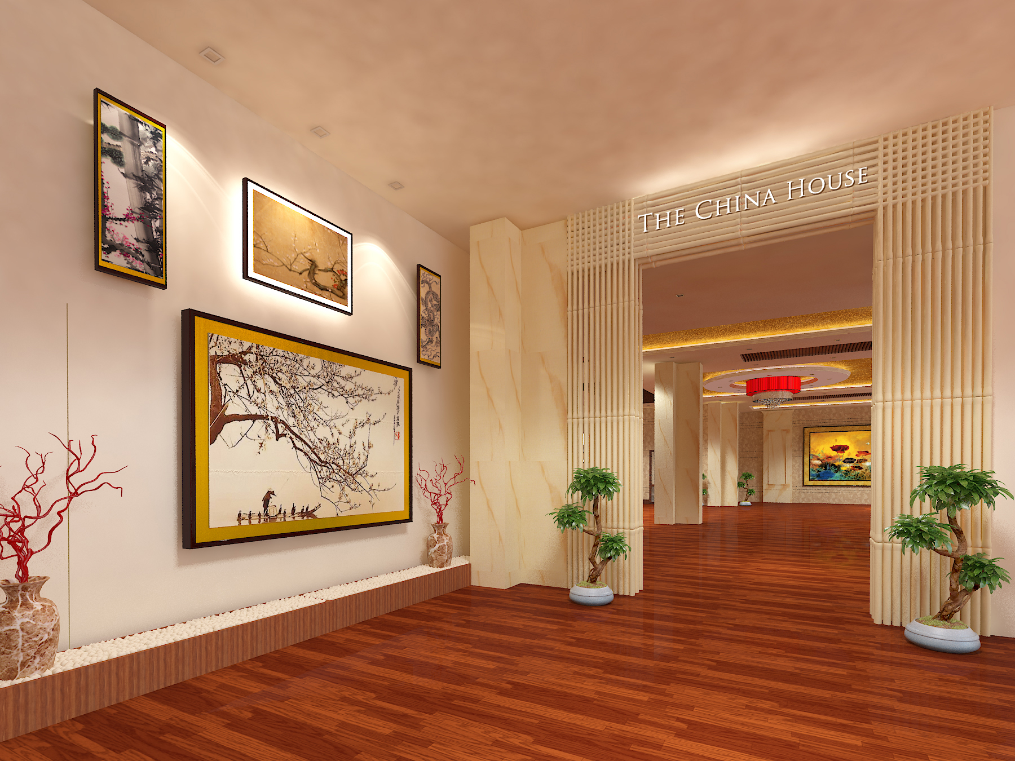
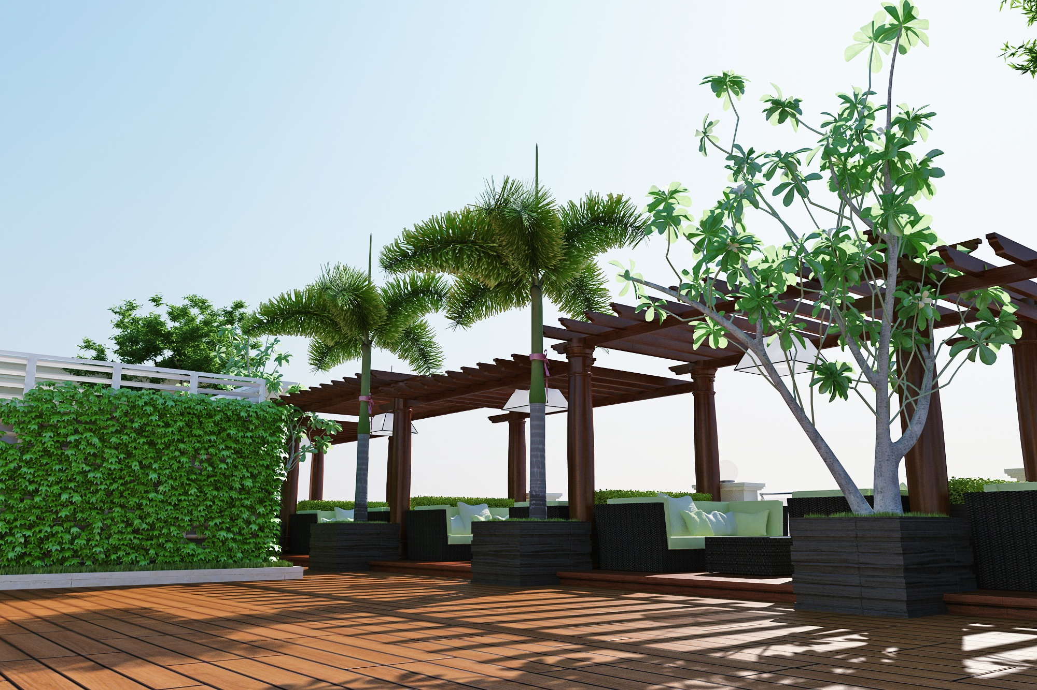
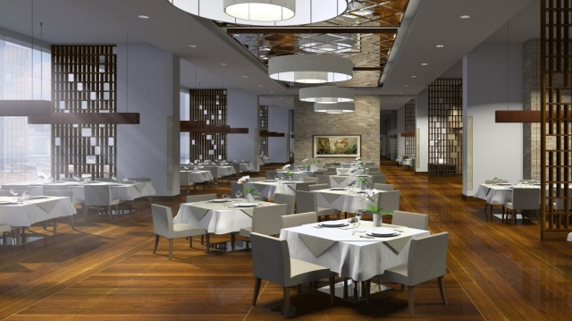
Lotus Restaurant
All day dinning
China House
Chinese
Thansur Restaurant
East meets West
Takezono Restaurant
Japanese
Bel Cibo Restaurant
Italian

Slide 17
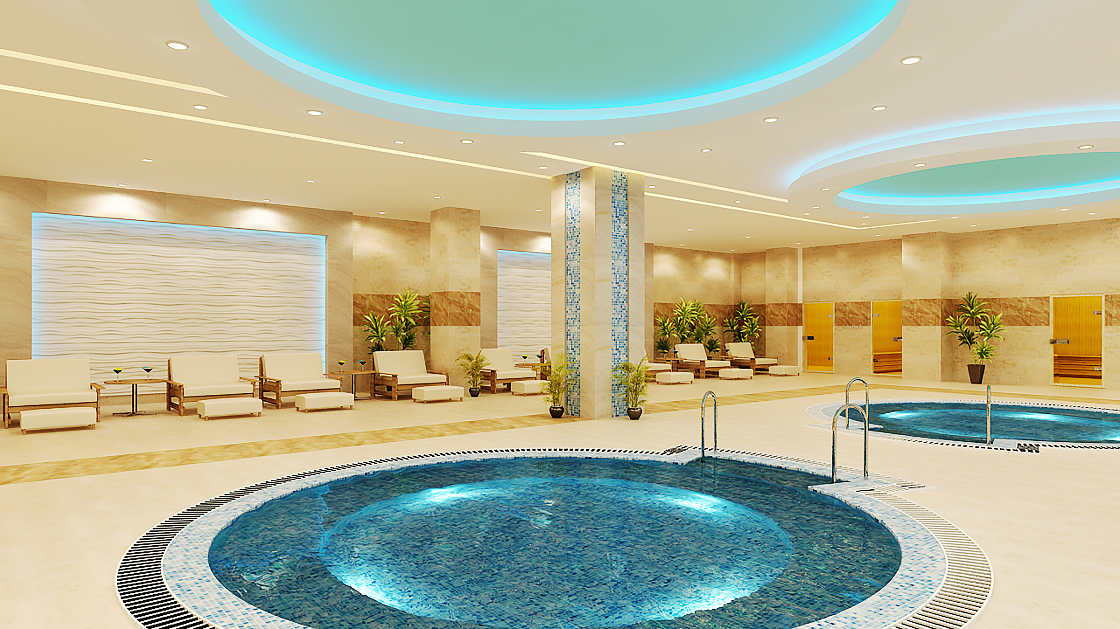
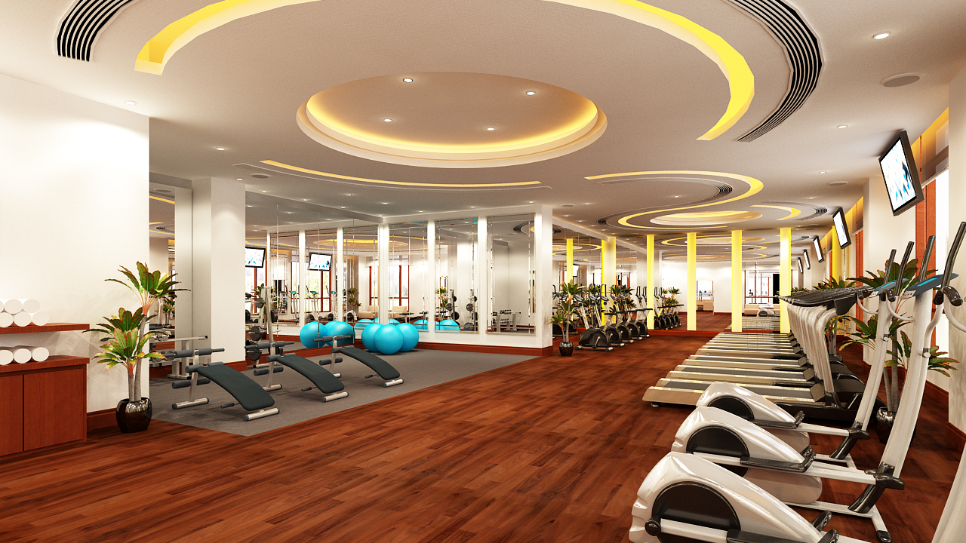
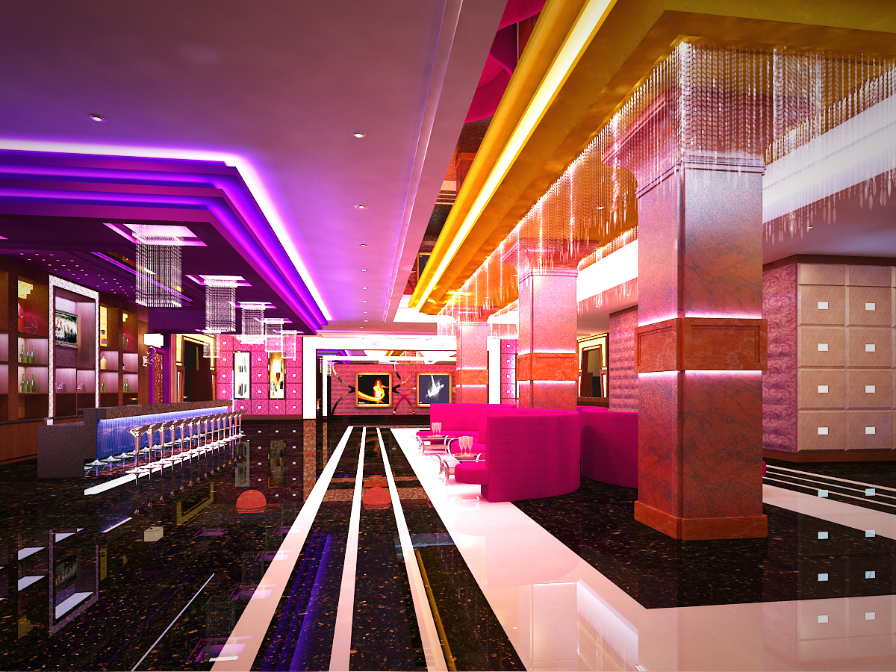
Jasmine Spa
Signature of Sokha
Fitness Centre
World class equipment
Beauty Salon
Karaoke
Kid’s Club
Lobby Lounge
Mekong Bar
Tonle Sap Bar

Slide 18
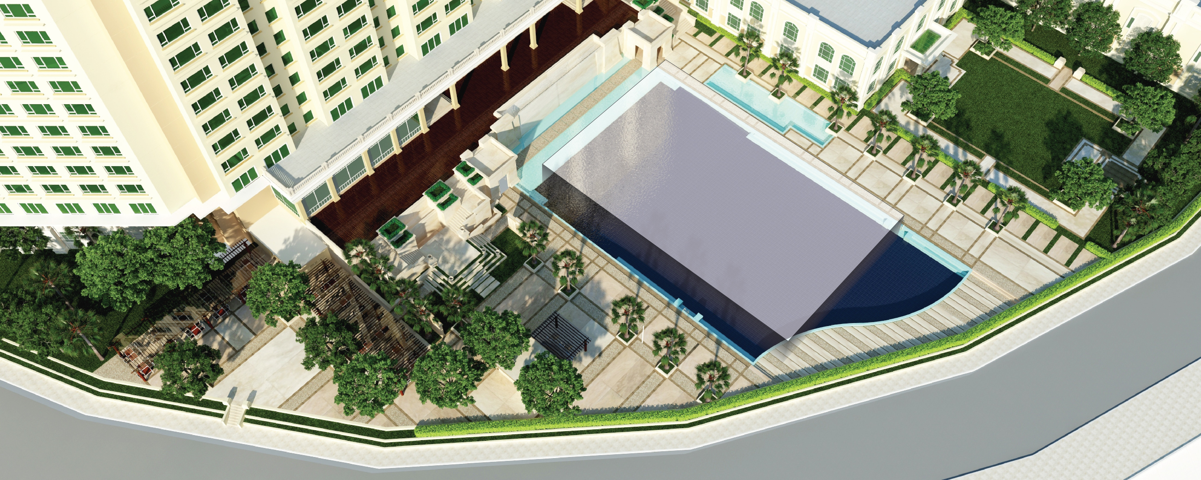
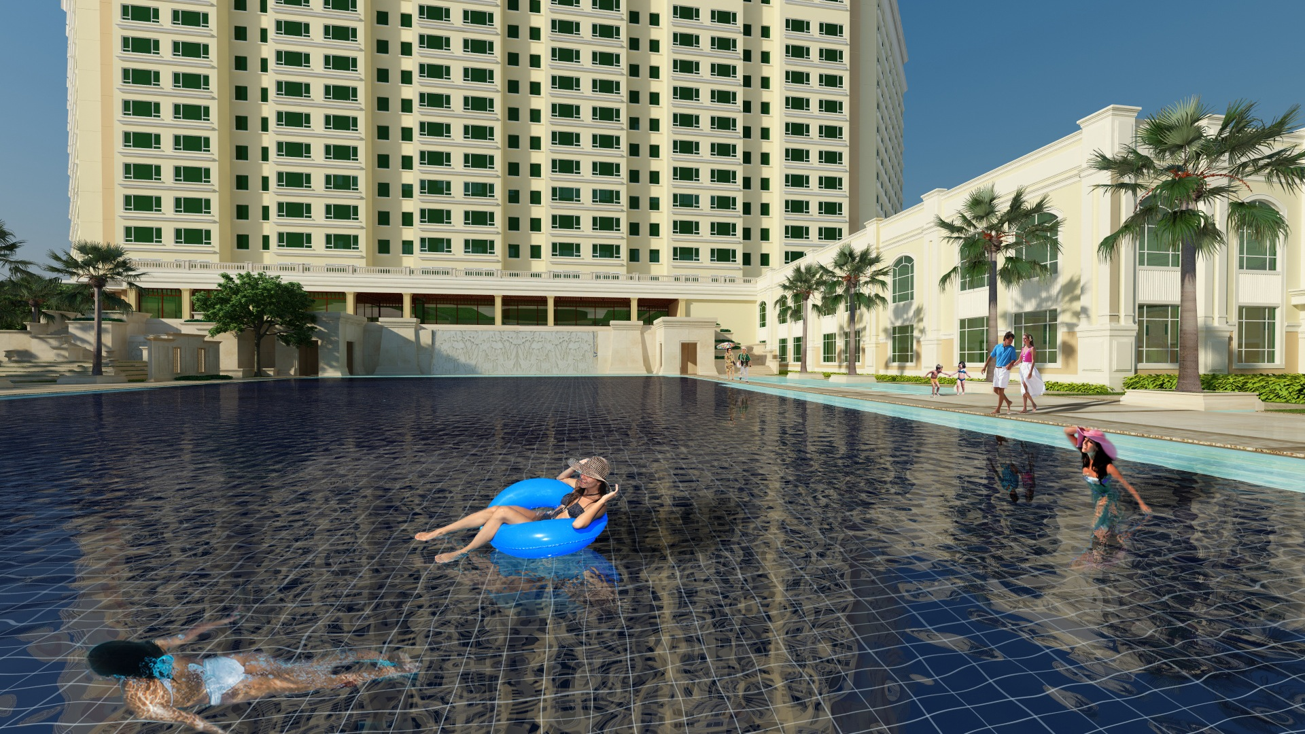
Swimming pool
Larger than international Olympic pool 1,650 sqm/ 17,760 sqf overlook Chaktomuk river and charming city, Phnom Penh

Slide 19

SOKHA PHNOM PENH RESIDENCE

Slide 20
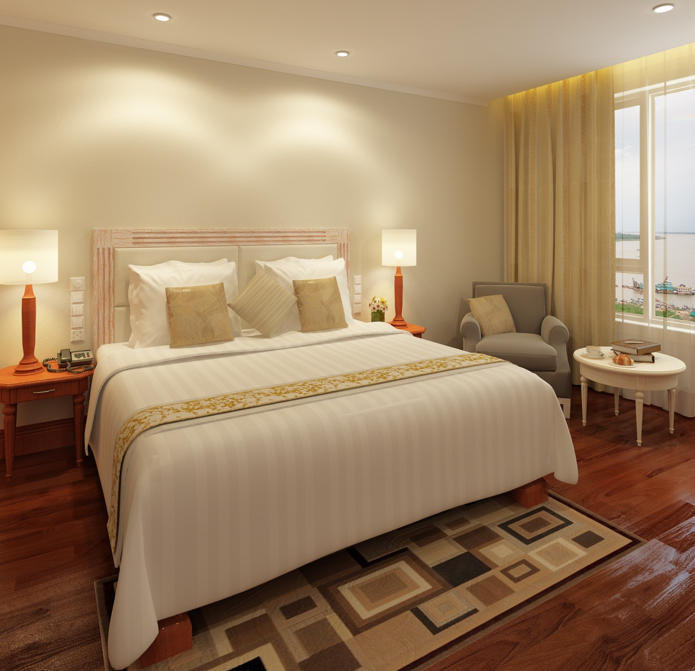
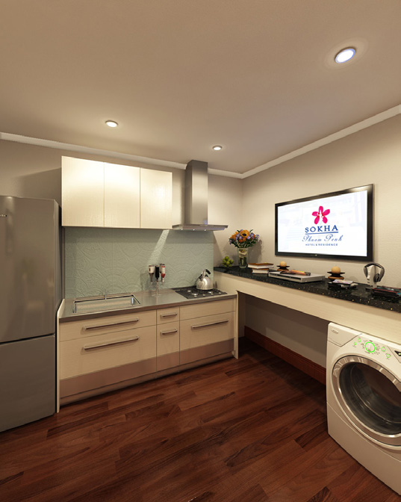
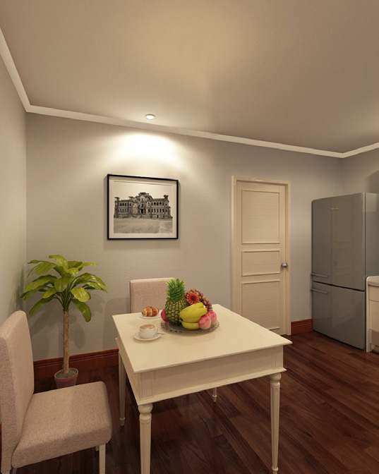
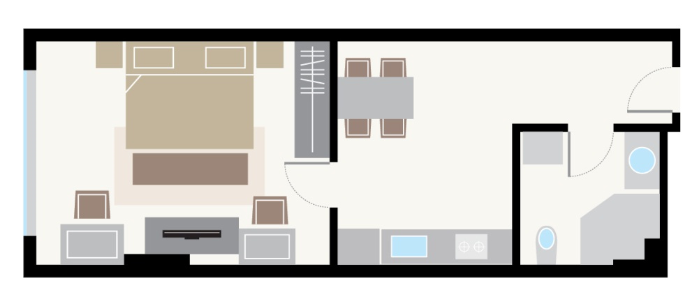
Bassac Suite (52 sqm/ 560 sqf)
Timber floor
Hotel facilities accessibility

Slide 21
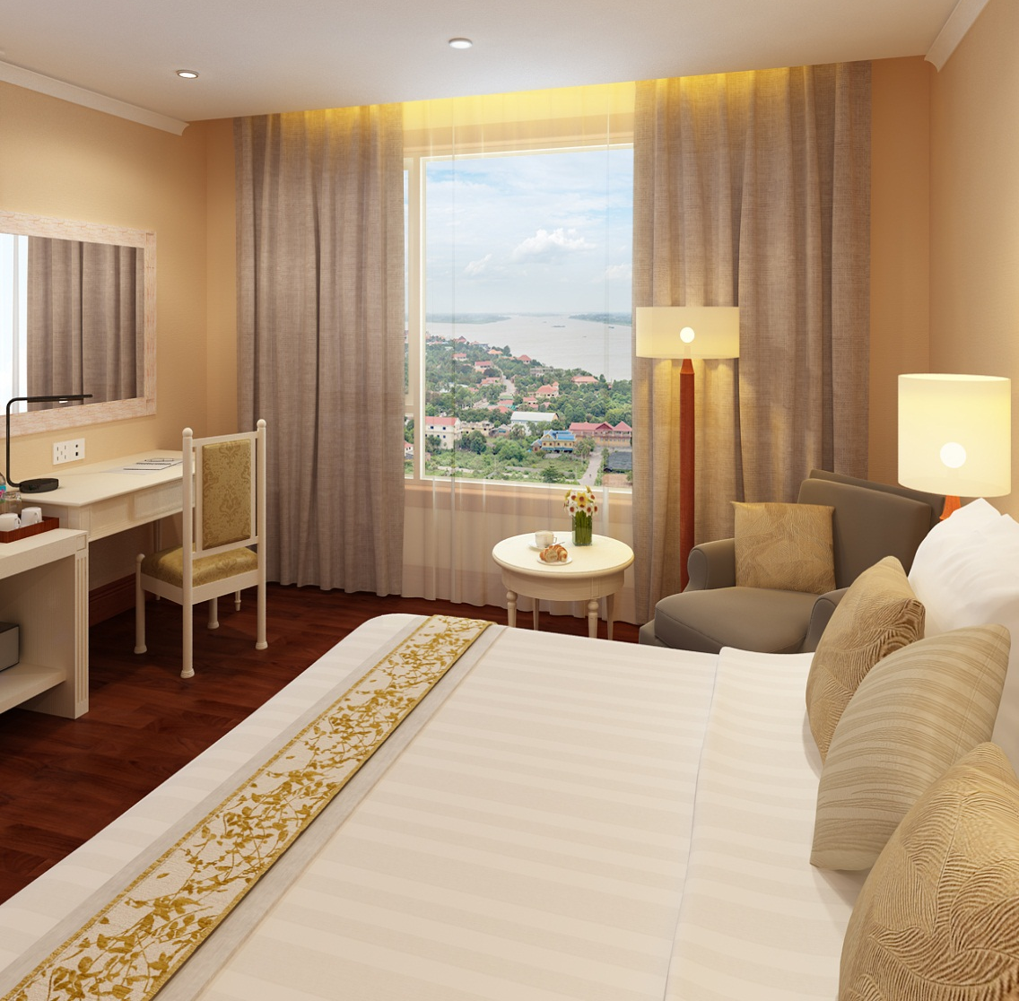
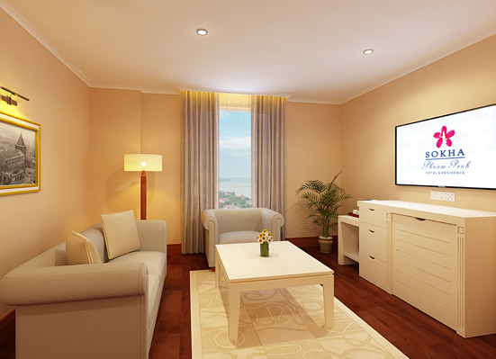
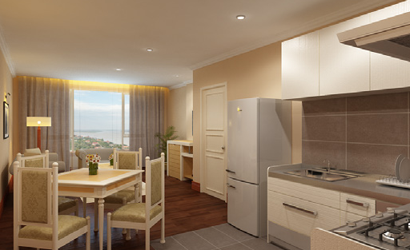
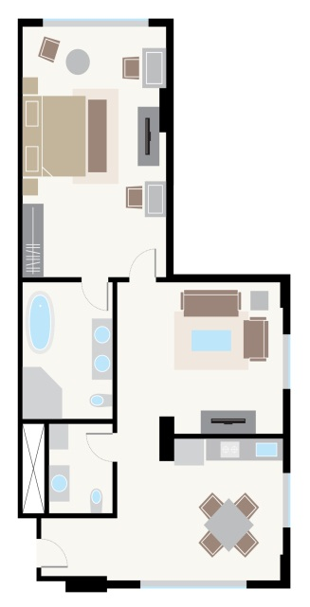
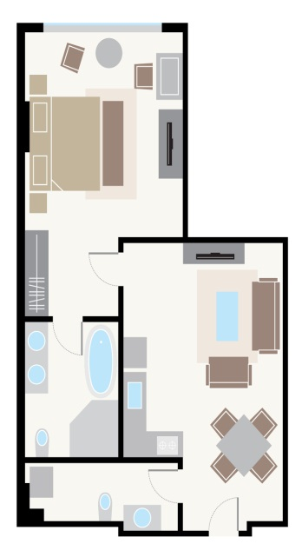
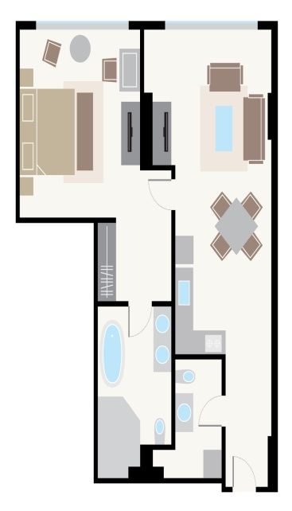
Tonle Sap Suite (90 sqm/ 969 sqf)
1 bedroom suite
Hotel facilities accessibility

Slide 22
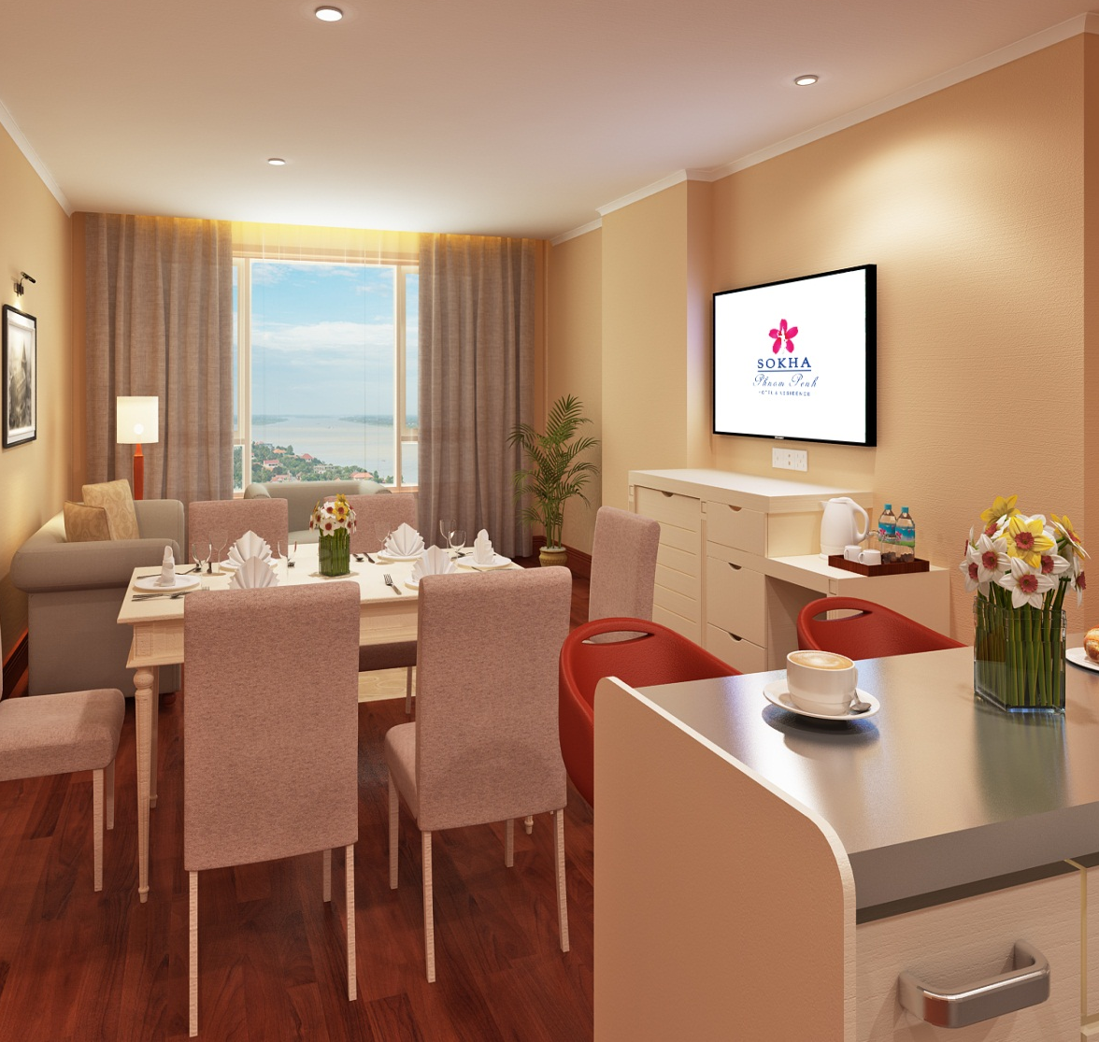
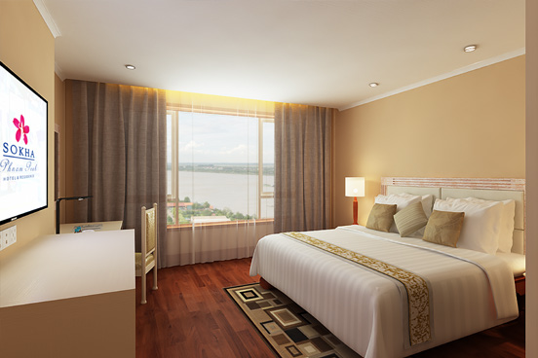
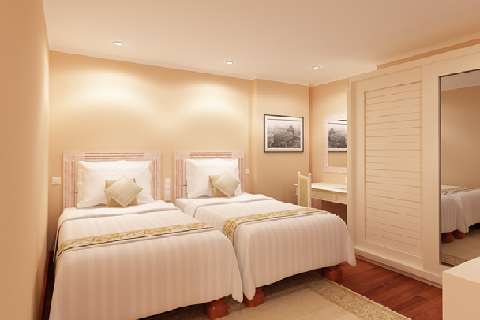
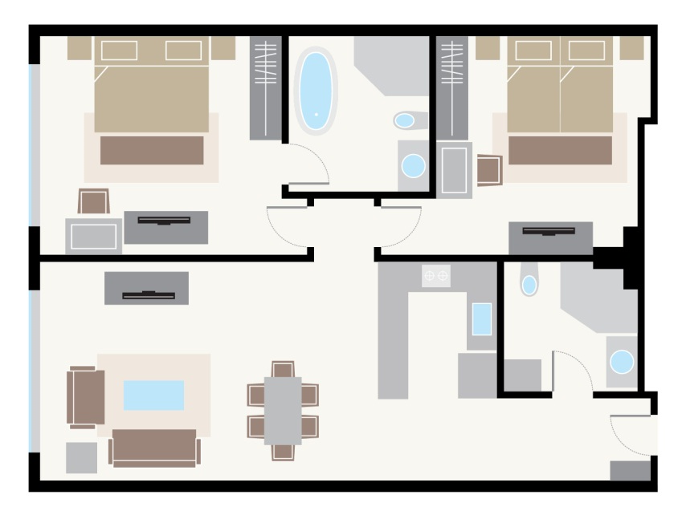
Mekong Suite (104 sqm/ 1,119 sqf)
2 bedrooms suite
Hotel facilities accessibility

Slide 23

ROOM FEATURES
Black out curtains
Coffee and tea making facilities
Mini bar
Wireless Internet access
Electricity AC 220 volts
Flat screen LCD TV
Hair dryer
Hard wood flooring
Individual controlled air-conditioning unit
Japanese high tech washlet
Personal safety box
International satellite TV channels
Spacious bathroom with full-sized bath and separate walk-in rain shower
Slippers & bathrobe
Smoke detector and sprinkler
Telephone extension in the bathroom
Universal power outlets

Slide 24
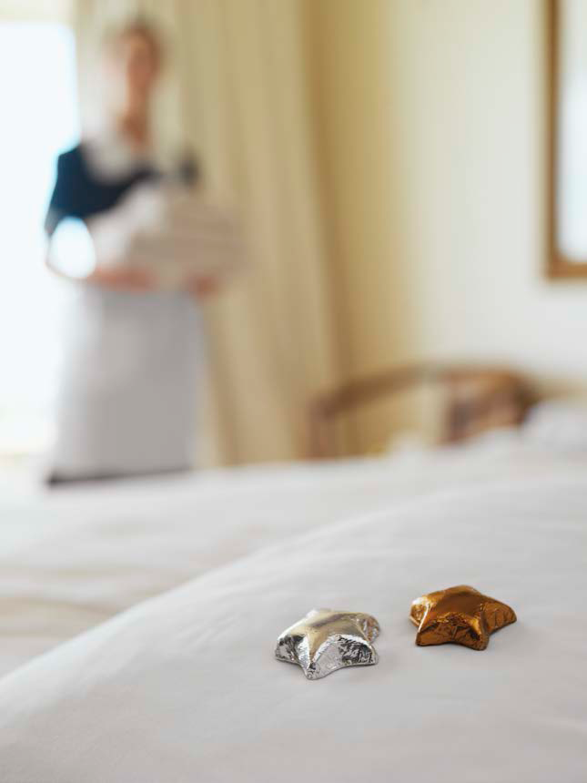
GUEST SERVICES
24 hour in-room dining
Airport transfer
Babysitting service
(with prior arrangement)
Boutique shop
Concierge desk
Foreign exchange
In-house clinic
Doctor on call (24 hour)
Laundry and dry-cleaning services
Limousine service
Postal/ Courier service

Slide 25
REASON TO CHOOSE SOKHA PHNOM PENH HOTEL & RESIDENCE
Offer spacious room configuration.
Can easily access to the popular attractions around Phnom Penh within 10 minutes.
Located strategically on Chroy Changvar Peninsula.
Offering breathtaking views of the majestic Royal Palace, Chaktomuk River, and provide the peaceful, less busy side of the congested capital city.
Largest swimming pool.
Largest meeting facility.
Complimentary unlimited internet access.
Varieties dining venue and entertainment venue.
Affiliated another 3 hotels located in the most popular tourist destination in Cambodia.

Slide 26
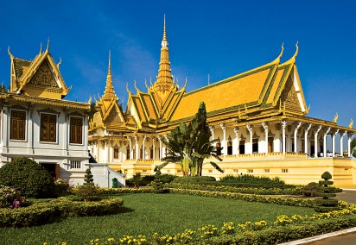
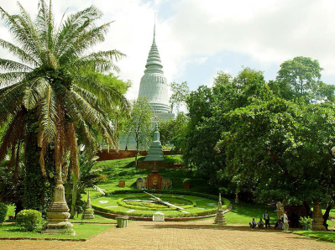
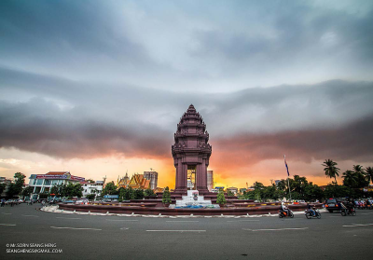
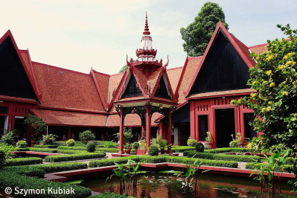
POINTS OF INTERESTS
Wat Phnom: 4 km from Sokha Phnom Penh Hotel & Residence.
Night Market (Phsar Reatrey): 4.5 km from Sokha Phnom Penh Hotel & Residence.
Central Market: 5 km from Sokha Phnom Penh Hotel & Residence.
National Museum: 6 km from Sokha Phnom Penh Hotel & Residence.
Royal Palace: 6 km from Sokha Phnom Penh Hotel & Residence.
Independence Monument: 7 km from Sokha Phnom Penh Hotel & Residence.
Riverside: The views of the rivers are amazing with the confluence of the Mekong, Tonle Sap and Bassac rivers just in front of the Royal Palace.

Slide 27


THANK YOU
____________
SOKHA PHNOM PENH HOTEL & RESIDENCE

